Slide 1

Mission Possible:
Transforming Lives Through Service
ICF Programs and Charities
Presented by:
Lisa Crudo, ICF Grand Treasurer
Notes:
Introductions
Welcome
Short explanation of handout
hold questions until the end please

Slide 2

Roadmap
ICF Programs & Charities
    Hospitalization Plan
    Scholarship Program
    Providenza Fund
    Gifts of Love
    Live to Give
    Cooley’s Anemia
How to Support: Fundraising
Q&A

Slide 3

Hospitalization Plan
Financial support for ICF members when hospitalized or have surgery
Elegibility
Any ICF member under 70
New members over 70 may enroll at time of joining ICF
Benefits
After 90 days:
  $75 for first day
  $50 for second day
  $25 for third day and beyond
$100 for surgery (inpatient or outpatient)
Up to $500/year
$500 max per illness
Important Notes
Must stay overnight in acute care facility (or outpatient surgery)
ER/Rehab/Convalescent not covered
Membership continues beyond age 70
Notes:
Clarification: – if you are a New Member to the I.C.F. who is over the age of 70 – you can enroll in the Hospital Plan as long as you enroll at the same time that you join and pay both membership and hospital plan dues.
Current Chairperson: Bob Acquistapace

Slide 4

Scholarship Program
Investing in Catholic Youth since 1964
Impact
Over $2 million awarded
More than 6,000 students supported
Award Amounts
1st year: $400 (~150 recipients)
2nd year: $500
3rd year: $600
4th year: $1000
Eligibility
Catholic high school seniors planning to attend college
Cumulative GPA 3.2+
Applicants from public and private schools in CA, NV, & IL
Application window every Spring
Notes:
Each spring, the Italian Catholic Federation receives nearly 200 applications for its yearly scholarship awards
Part of the criteria: Are Roman Catholic and of Italian Descent and live within the Roman Catholic Dioceses of California, Illinois and Nevada, only where Branches of the Federation are established; or,
Are Roman Catholic but need not be of Italian Descent or live where Branches of the Federation are established if either Roman Catholic parent, guardian or grandparent is a member of the “Italian Catholic Federation.”
Students who win a first year scholarship automatically receive the application for the second year.
Current chairperson: Carmen Kilcullen

Slide 5
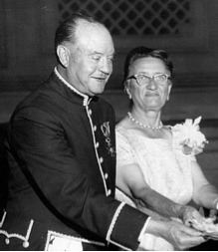
Providenza Fund
Encouraging religious vocation through financial aid
History
Named for Sir Luigi and Lady Augusta Providenza
Supports
Seminarians in CA, NV & IL
Bishop’s Day program
Notes:
Most often overlooked charity
Currently just over $36,000.00 in the fund
Consider donating in memory of a loved one, or in celebration of an event

Slide 6

Gifts of Love
Financial support for disabled children and adults
Highlights
Provides grants to disabled people seeking support for greater independence
Focus on inclusion and empowerment
Impact
Over $750,000 Donated
Fosters greater inclusion for people with disabilites
Notes:
The program began in September 1996.
As of the end of June, we have received $791,271.37 in donations.
awards granted of $751,960.41 since the inception of the program.
Funds may be allocated to the following: individual applicants, non-profit agencies and educationally-focused institutions. Grant determined by the Gifts of Love Committee of the I.C.F.
Current chairperson: Theresa Helfand

Slide 7


Live to Give:
Promoting life-saving acts of generosity through blood and organ donation awareness
Focus Areas
Blood donation drives
Organ donor registration and education
Impact
Inspiring members to give the gift of life
Notes:
Blood drives are held during our yearly national convention,
Units collected this year: _____
Individual branches/districts may hold blood drives throughout the year.
Consider adding donor to your driver’s license

Slide 8
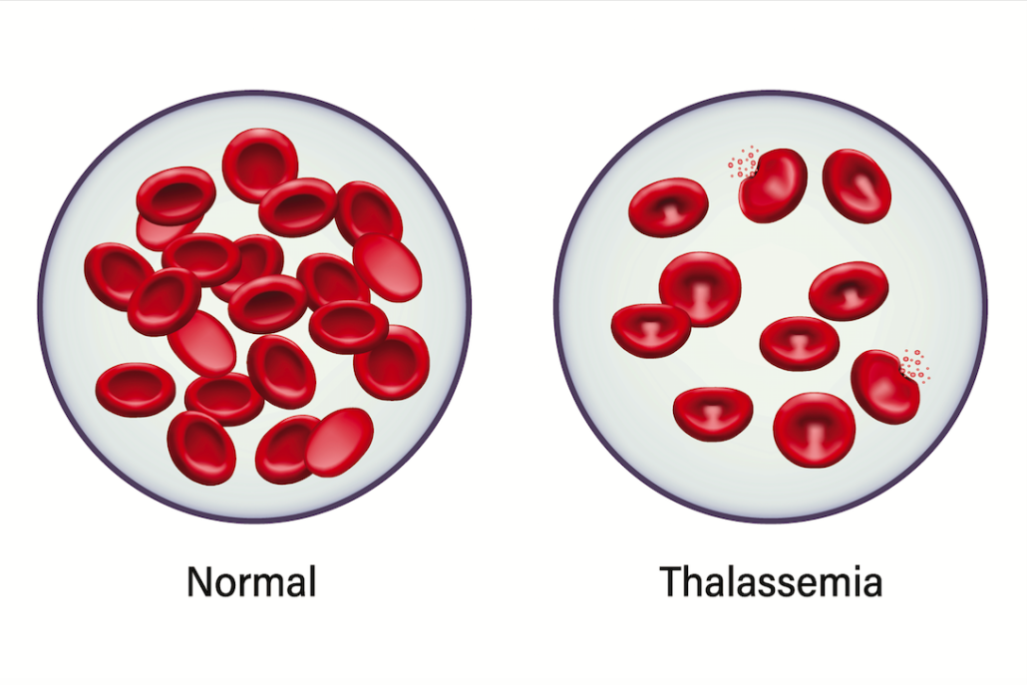

Cooley’s Anemia: Our National Charity
Supporting quality of life and research for a cure
What is Cooley’s Anemia?
Severe form of Thalassemia, a genetic blood disorder
Primarily impacts individuals of Mediterranean descent
Currently requires frequent blood transfusions
ICF’s Role
Funding research and treatment initiatives
Over $2 million in donations to date
Raising community awareness
Notes:
Voted on as our National Charity
Lots of information on the ICF.org website
Guest speaker Laurice Levine

Slide 9


Faith in Action: Fundraising
How you and your branch can support our programs
Ideas and Initiatives
Fundraising ideas
Consider including one of the charities in your estate plans to help ensure our mission continues for generations
Invite guest speakers to your branches
Help ensure our mission continues for generations
Notes:
Call up guest members to speak on fundraising ideas

Slide 10
Q&A

Slide 11
Grazie per la vostra attenzione!
-For any additional questions or information, don’t hesitate to contact me or the ICF Office!
Lisa Crudo, ICF Central Council
Lisa.m.crudo@gmail.com
ICF Office
info@icf.org
(510) 633-9058

Slide 12

Notes:

